Slide 1
MySQL BASICS
Diego Silva

Slide 2
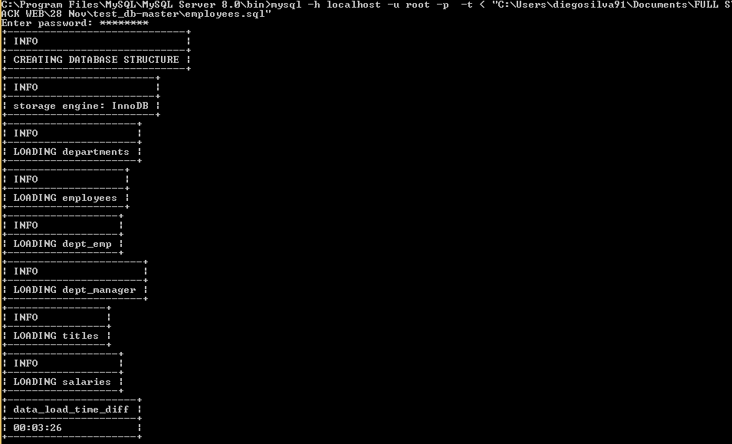
How to import a database?
Open CMD.
CD to the directory where is the file mysql.exe in folder.
Write mysql -h servername -u username -p -t < "dir_file\name_file.sql”. If the user has pass, write it else leave the field empty and press enter.
Ensure the file is on the directory name.

Slide 3
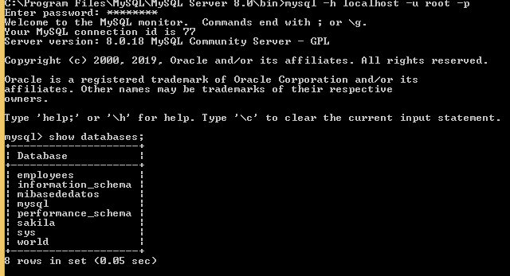
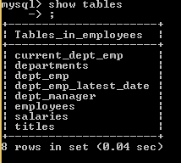
How to make inquiries?
Connect to MYSQL.
Access to MYSQL.
Write in command line
mysql –h servername -u username –p.
If the user has pass write it else leave the field empty and press enter.
Write
Execute the query you want.
show databases;
use name_database;

Slide 4
What kind of queries exist and their syntax
Sentences that can be used to perform various tasks.
Depending on the tasks, these sentences can be classified into three main groups (DML, DDL, DCL)

Slide 5
What kind of queries exist and their syntax

Slide 6
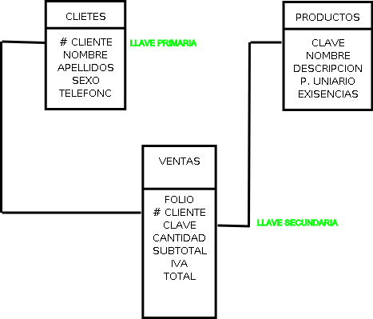
What kind of keys exist?
We can create restrictions to ensure the integrity of the data stored in our tables.
These restrictions can be implemented at the time of creating our tables or modifying them.
Require a unique name composed of the name of the scheme to which it belongs and the name that identifies it.
The different types of restrictions that exist are:
PRIMARY KEY.
UNIQUE.
FOREIGN KEY.
CHECK.
DEFAULT.
SchemaName.restrictionName.

Slide 7
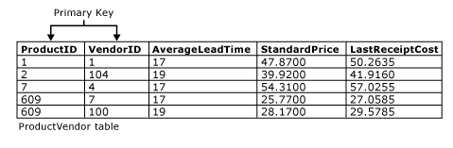
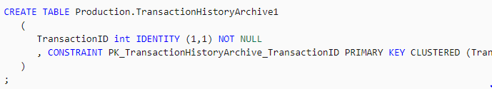
PRIMARY KEY.
It is the most common of all.
To be a relational table must always have a primary key to identify that identify that row as UNIQUE.
It is possible to add more columns as part of a primary key.
To use a nomenclature in the name of the restriction is a good practice.
Each time we generate a primary key, it creates an index type of clustered automatically.
The column (s) used in a PRIMARY KEY constraint cannot accept NULL.
You cannot repeat values ​​in the column (s), they must be unique.
Only one PRIMARY KEY type constraint can exist for each table.

Slide 8

UNIQUE
This type of restriction is very similar to PRIMARY KEY.
The differences are as follows:
It also generates an index automatically but is of the NON CLUSTERED type.
The table can have more than one UNIQUE type constraint.
If you can accept NULL, but only one row can contain it since, as the name implies, it is UNIQUE or unique.

Slide 9
FOREIGN KEY
It is formed of a column or the combination of several columns of a table that serves as a link to another table where in the latter.
A foreign key does not create an index automatically, so it is recommended to generate one to increase the query performance.
Some requirements for the FOREIGN KEY restriction:
The values ​​entered in the foreign key column (s) must exist in the table referred to in the primary key column (s).
You can only refer to primary keys of tables that are within the same database.
You can refer to other columns in the same table.
You can only refer to PRIMARY KEY or UNIQUE constraint columns.
It cannot be used in temporary tables.

Slide 10
Check
With this type of restriction, it is specified that the values ​​entered in the column must comply with the specified rule or formula.
Some requirements are:
A column can have any number of CHECK restrictions.
The search condition must be evaluated as a Boolean expression and cannot refer to another table.
You cannot define CHECK restrictions in columns of type text, ntext or image.
Advantage:
The expressions used are similar to those used in the WHERE clause.
They can become a better alternative than TRIGGERS or triggers.

Slide 11
Default
It can be said that it is not a restriction, since only one value is entered in case no other is specified.
If a column allows NULL and the value to be inserted is not specified
It can be replaced with a default value.

Slide 12
What kind of data exists and what is each used for?

Slide 13
What kind of data exists and what is each used for?

Slide 14
What is a collation, such as utf8_general_ci or utf8_spanish_ci and what are its differences
Def. refers to a set of rules that determine how data is sorted and compared. Character data is sorted using rules that define the correct character sequence, with options for specifying case-sensitivity, accent marks, kana character types and character width.
These two collations are both for the UTF-8 character encoding.
The main difference is in how text is sorted and compared.
utf8mb4_unicode_ci is based on the official Unicode rules for universal sorting and comparison.
which sorts accurately in a wide range of languages.
Utf8mb4_general_ci is a simplified set of sorting rules which aims to do as well as it can while taking many short-cuts designed to improve speed.
It does not follow the Unicode rules.
It result in undesirable sorting or comparison in some situations, such as when using particular languages or characters.

